Slide 1



DermaCare Hub
every skin tells a story

Slide 2

1
Susanna Samy Daniel
2
Clara Hany Wasfy
Team
Members
3
Omnia Mansour Abd Elnasser
4
Aya Ehab AbdelTawab
5
Laila Hader Elhilaly
6
Dalia Mohamed Gamal Eldin Ali

Slide 3
Problem Statement
1
2
Project Idea
Target Audience
3
Key Features
4
Agenda
Technology Stack
5
Topics Covered
6
How the Platform Works
Project Development Stages
7
8
Future Development
Monetization Plan
9
10
Team Roles

Slide 4

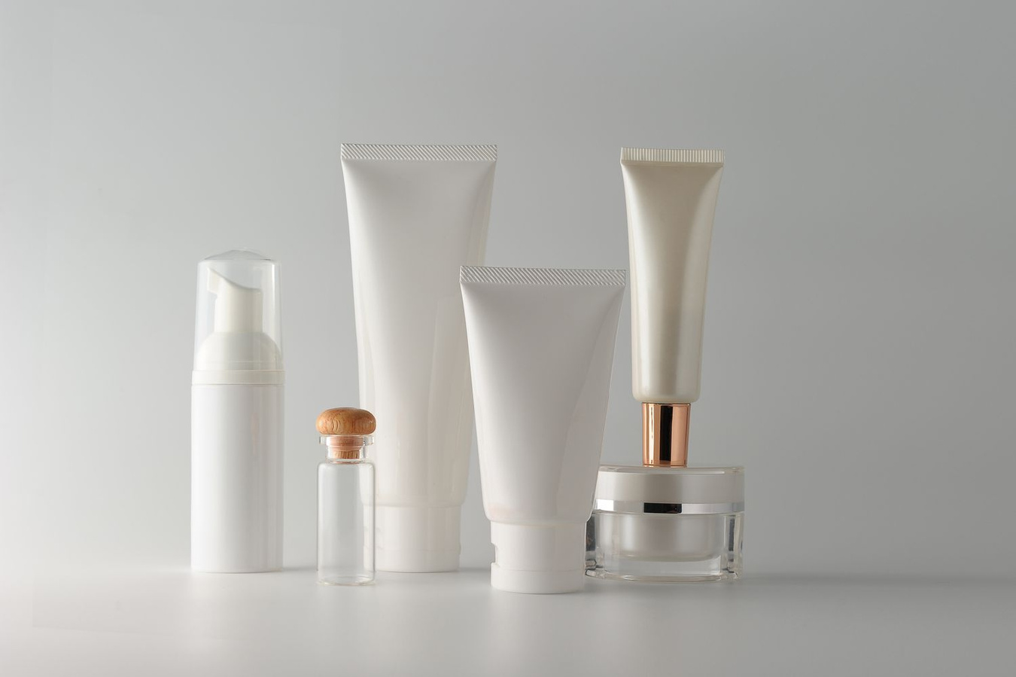
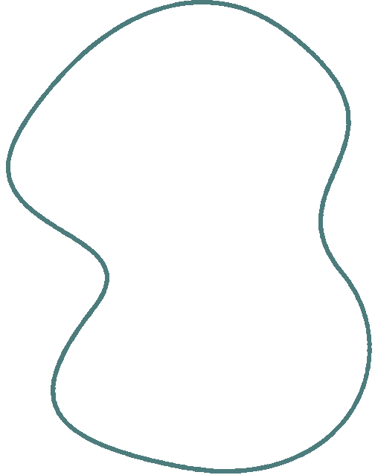
DermaCare Hub
An online platform for skin, hair, and body care.
A comprehensive website that provides reliable medical information and trusted products in the field of personal care

Slide 5

Problem Statement
Many people face skin, hair, or body issues without knowing the cause or how to deal with them.
Lack of awareness of trusted and easy-to-understand medical information.
Difficulty finding suitable products or knowing where to buy them.

Slide 6



Project Idea
A website that offers:
Initial condition assessment through:
An AI Chatbot that analyzes the symptoms entered by the user and
provides possible conditions.
An interactive questionnaires (quiz) based on diagnostic questions that
provides advice according to the user’s answers.

Slide 7
Skin disease encyclopedia for skin, hair, and body, including:
Symptoms.
Ways to deal with the condition.
Suggested medications (OTC or prescribed).
Products section: Display and sell skin, hair, and body care products with the option to know where to buy or purchase online.

Slide 8


Target Audience
People interested in personal care.
Those who suffer from skin, hair, or body problems.
People looking for trusted products.
Age range: 16–45 years old.

Slide 9




AI chatbot for initial assessment.
Key
Features
Accurate interactive questionnaires.
Comprehensive skin disease encyclopedia.
Product section with buying options and reviews.
Monthly challenges and progress check-ins.

Slide 10


Technology Stack
1
Front-End: HTML, CSS, JavaScript, React.js
2
Back-End: Python (Django or Flask)
3
AI: Integration with Natural Language Processing (NLP) model
4
Hosting: AWS or HerokuDatabase (MySQL or PostgreSQL)
5
Payment Integration: Paymob or Fawry

Slide 11


The user visits the website.
Chooses between:
Talking to the chatbot for simple advice.
taking questionnaires.
sharing pictures to identify any diseases / document progress.
browsing the products section.
How the Platform
Works

Slide 12
Project Development Stages
1
Data collection: Skin diseases and trusted products
2
UI/UX design.
3
Front-end development.
4
Back-end development and database integration.
5
Adding the chatbot and interactive questionnaire.
6
Testing and launch.

Slide 13


Future
Development
Add reviews and ratings for products.
Provide a mobile application (Android & iOS).

Slide 14

Monetization Plan
Direct product sales through the platform
Affiliate marketing with other sellers.
Make extra features with subscription
Targeted advertisements for personal care audiences.

Slide 15

Team Roles
Front-End Developer: Designs and codes the user interface.
Back-End Developer: Develops the server and database connections.
AI Developer: Builds the chatbot and questionnaire logic
Content Creator: Prepares and writes trusted medical content.
UI/UX Designer: Creates a user-friendly and attractive interface.

Slide 16
Conclusion
This project provides an innovative digital solution combining:
Smart initial assessment.
Trusted medical awareness.
E-commerce in personal care.
Our goal is to make it easier for users to access the right information and products quickly and reliably.

Slide 17
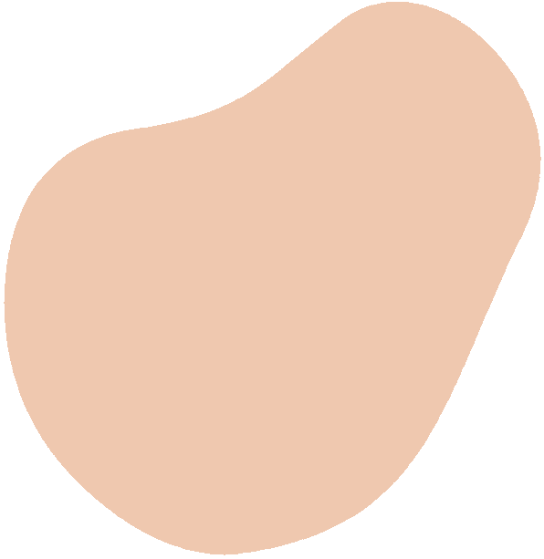
Thank you!

